Slide 1
Digital Portfolio
STUDENT NAME: DHARUN S
REGISTER NO AND NMID: asanm40324134031802521016
DEPARTMENT: B.sc, computer science
COLLEGE: COLLEGE/ UNIVERSITY:PSPT MGR arts and sciences College,puthur

Slide 2
PROJECT TITLE
“Bridging the Gap Between Small Restaurants and Customers Online”
“The Need for a Digital Platform for Small Restaurants”
“Improving Customer Reach with a Restaurant Website”

Slide 3


AGENDA
Problem Statement
Project Overview
End Users
Tools and Technologies
Portfolio design and Layout
Features and Functionality
Results and Screenshots
Conclusion
Github Link
3/21/2024 Annual Review

Slide 4

PROBLEM STATEMENT
Problem Statement : Small restaurants often lack a proper online presence, making it difficult for customers to find essential information such as menus, opening hours, and contact details. This reduces customer reach and business opportunities. A simple and responsive restaurant website can solve this problem by providing an accessible platform that connects restaurants with customers.

Slide 5

Project overview
2. Project OverviewThis project is a restaurant website developed using HTML, CSS, and JavaScript. The website provides an interactive and user-friendly interface where customers can explore the restaurant’s menu, learn about services, check opening hours, and contact the restaurant. The main objective is to help small businesses establish an online presence and attract more customers.

Slide 6

WHO ARE THE END USERS?
3. End UsersRestaurant Owners → To showcase their business and menu online.Customers → To easily access restaurant details, menu, location, and contact information.Food Enthusiasts → To explore new dining options.

Slide 7

TOOLS AND TECHNIQUES
1. HTML5 → Structure of the website.2. CSS3 → Styling, layout, and responsiveness.3. JavaScript → Interactivity and dynamic features.4. VS Code → Code editor.5. GitHub → Version control and project hosting.

Slide 8
POTFOLIO DESIGN AND LAYOUT
5: Portfolio Design and Layout for a restaurant website. It outlines the structure and content of the site with a clean, modern layout, consisting of the following sections:Home Page → Introduction and welcome message.About Us → Restaurant background and mission.Menu Page → Categorized food and drinks list with prices.Gallery → Food and restaurant images.Contact Page → Contact form, address, and map integration.
8

Slide 9
FEATURES AND FUNCTIONALITY
6. Features and FunctionalityResponsive design (works on mobile, tablet, and desktop).Interactive navigation bar.Menu display with categories.Contact form for reservations and inquiries.Embedded Google Maps for location.Social media integration.

Slide 10
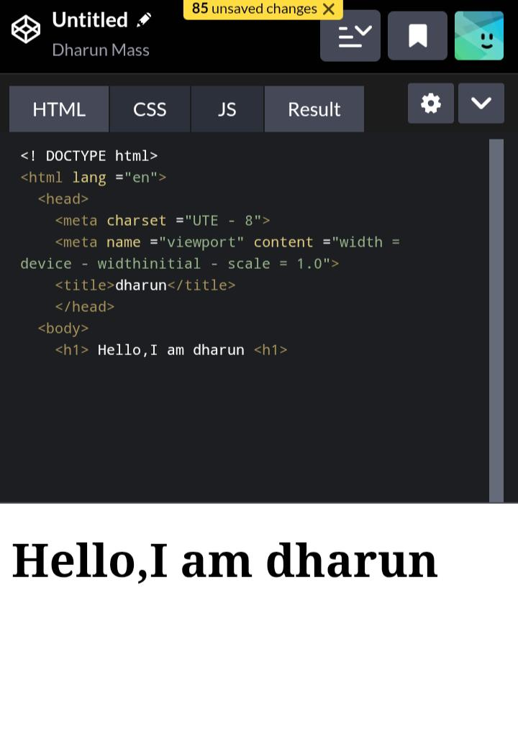

RESULTS AND SCREENSHOTS
3/21/2024 Annual Review
10

Slide 11
CONCLUSION
-8. ConclusionThe restaurant website successfully provides small businesses with an affordable and effective online presence. It improves customer engagement and ensures that essential information such as menus, location, and contact details are easily accessible. This project demonstrates the practical use of HTML, CSS, and JavaScript in creating real-world solutions.
11

